Slide 1
Data Mining and Predicting Heart Disease Risk with Machine Learning: A Comprehensive Analysis
Sanjeev Kumar Srinivasan Khannan

Slide 2
Introduction
Cardiovascular disease (CVD), including heart disease, is a major cause of morbidity and mortality worldwide.
Identifying high-risk individuals for heart disease is crucial for early intervention and management to improve health outcomes.
Machine learning has emerged as a powerful tool for analyzing large and complex datasets, including those in the healthcare domain.
In this project, we aim to develop a machine learning model to predict the likelihood of an individual having heart disease based on various risk factors such as BMI, smoking, alcohol drinking, physical activity, age, sex, race, and other health conditions.
This project can help healthcare providers identify high-risk individuals and implement appropriate interventions to prevent or manage heart disease.
Preprocessing and feature engineering techniques will be used to handle the mix of binary, categorical, and continuous data columns.
The project presents an opportunity to explore the usefulness of these techniques in machine learning for healthcare applications.

Slide 3
Review and Validation of Input Features
The dataset used in this study was obtained from Kaggle and was originally derived from the Behavioral Risk Factor Surveillance System (BRFSS) 2020 dataset, which is a large and comprehensive survey of the health status of U.S. residents conducted annually by the CDC.
The Kaggle dataset used in this project was shortened by another author to include only the most relevant variables for predicting heart disease, resulting in a dataset with 20 variables.
The selected features have been reviewed and validated based on their relevance to heart disease prediction and their established links to heart disease risk factors.
The binary features included are Smoking, AlcoholDrinking, Stroke, DiffWalking, PhysicalActivity, Asthma, KidneyDisease, and SkinCancer.
The Sex feature is also included as a binary feature because heart disease incidence and mortality rates differ by gender.
The Race feature is categorical and includes six categories: White, Black, Asian, American Indian/Alaskan Native, Other, and Hispanic, as there is evidence that heart disease incidence and mortality rates vary by race and ethnicity.
The Diabetic feature is categorical and includes four categories: Yes, No, No (borderline diabetes), and Yes (during pregnancy), as there is a strong link between diabetes and heart disease.

Slide 4
Review and Validation of Input Features - Contd
The AgeCategory feature is categorical and includes fourteen categories that span from 18-24 to 80 or older, as age is a well-established risk factor for heart disease.
The GenHealth feature is categorical and includes five categories: Very good, Fair, Good, Poor, and Excellent, providing information on the respondent's self-reported general health status, which is another important predictor of heart disease.
The BMI feature is a continuous feature providing information on the respondent's body mass index, which is a well-established risk factor for heart disease.
The PhysicalHealth feature is a continuous feature providing information on the number of days in the past 30 days that the respondent reported physical illness or injury, and the MentalHealth feature provides information on the number of days in the past 30 days that the respondent's mental health was not good.
The SleepTime feature provides information on the respondent's average hours of sleep per 24-hour period, which is also known to be a factor in heart disease risk.
The inclusion of both categorical and continuous features provides a comprehensive picture of the respondent's health status and lifestyle factors that can influence their risk of developing heart disease.

Slide 5
Review and Validation of the Outcomes
Machine learning models used: Support Vector Classifier, GradientBoostingClassifier, and Extra Trees Classifier
Dataset is imbalanced with a significantly higher number of "No" heart disease outcomes than "Yes" outcomes
To address imbalanced dataset, undersampling techniques such as RandomUnderSampler and NearMiss were employed during cross-validation, which included K-Fold splitting
Preprocessing steps applied: encoding categorical variables based on weighted averages.
Metrics used for evaluation: accuracy, precision, recall, F1 score, and ROC-AUC curve
The original dataset consists of over 400,000 rows and 279 columns, while the version used in this paper includes approximately 20 relevant variables directly or indirectly related to heart disease
Target variable is "HeartDisease", a binary variable with two possible values: "Yes" indicating the presence of heart disease and "No" indicating the absence of heart disease
Models' performance was evaluated based on their ability to accurately predict the presence or absence of heart disease, given the selected input features and imbalanced nature of the dataset.

Slide 6
Data Preprocessing - Data Cleaning
Data cleaning was the first step in the data processing phase to ensure the dataset was free from any missing or null values.
The initial dataset comprised 319,795 entries and 17 columns, including the target column.
The target column 'HeartDisease' had a class imbalance issue, with 292,422 entries labeled as 'No' and only 27,373 entries labeled as 'Yes'.
This class imbalance could result in bias towards the majority class in the model, affecting its performance.
To address this issue, undersampling techniques were applied using imblearn's RandomUndersampling with a 'sampling_strategy' hyperparameter set to 'majority'.
This technique reduced the total dataset size to 54,746, with 27,373 entries for each class, ensuring a balanced dataset for further analysis.

Slide 7
Data Preprocessing - Feature Engineering
Binary features in the dataset were converted to categorical variables with values of 'Yes' and 'No' and then encoded as integers with a value of 1 assigned to 'Yes' and 0 assigned to 'No'.
Continuous columns required preprocessing before feature engineering
'PhysicalHealth' and 'MentalHealth' were scaled by dividing them by 30 (maximum number of days in a month)
'SleepTime' was normalized by dividing values by 24 (maximum number of hours in a day)
Scaling and normalization ensure that the features fall between 0 and 1, which is common in machine learning
Log transformation was applied to the BMI feature to normalize the data. The original distribution was right-skewed, with most of the entries falling between 20 to 40. After log transformation, the data appeared to be distributed normally, with the mean falling around 3.25 in both the training and test sets.
The BMI feature was log-transformed to ensure that some of the machine learning models that expect normally distributed feature values can work with this feature. The transformation was applied separately to the training and test sets to prevent data leakage. After log transformation, the feature was normalized and could be used effectively in the modeling stage.

Slide 8
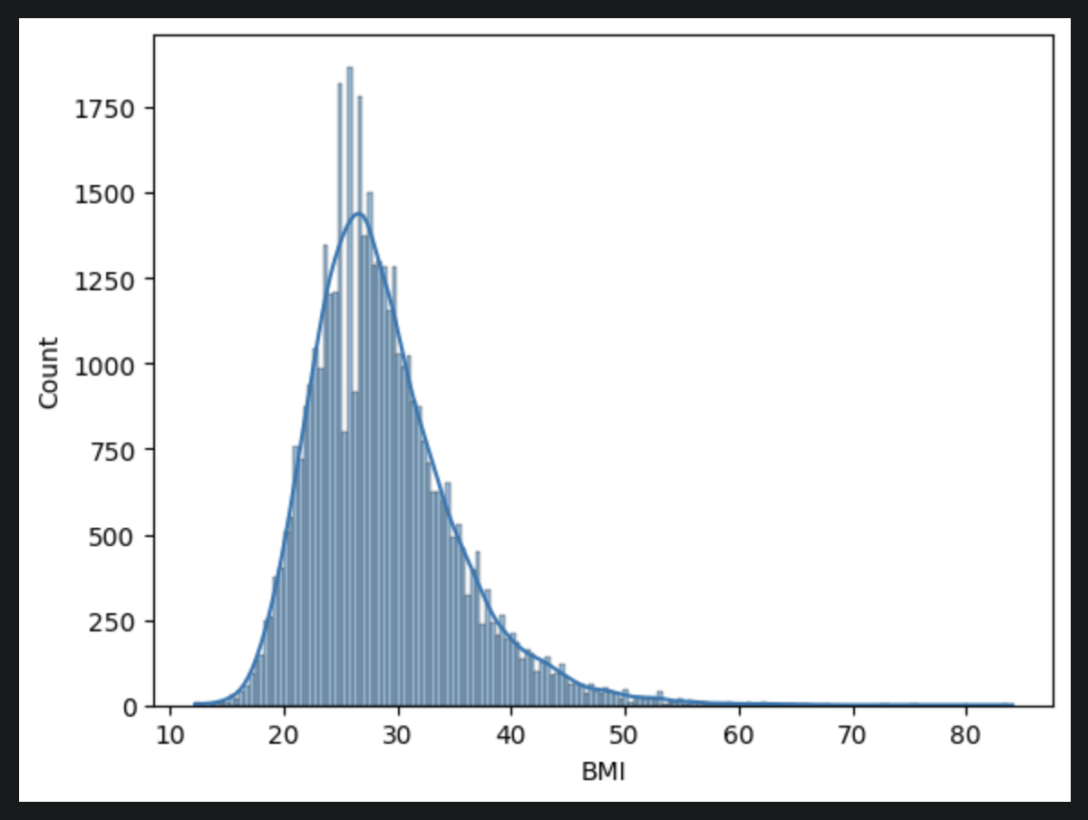
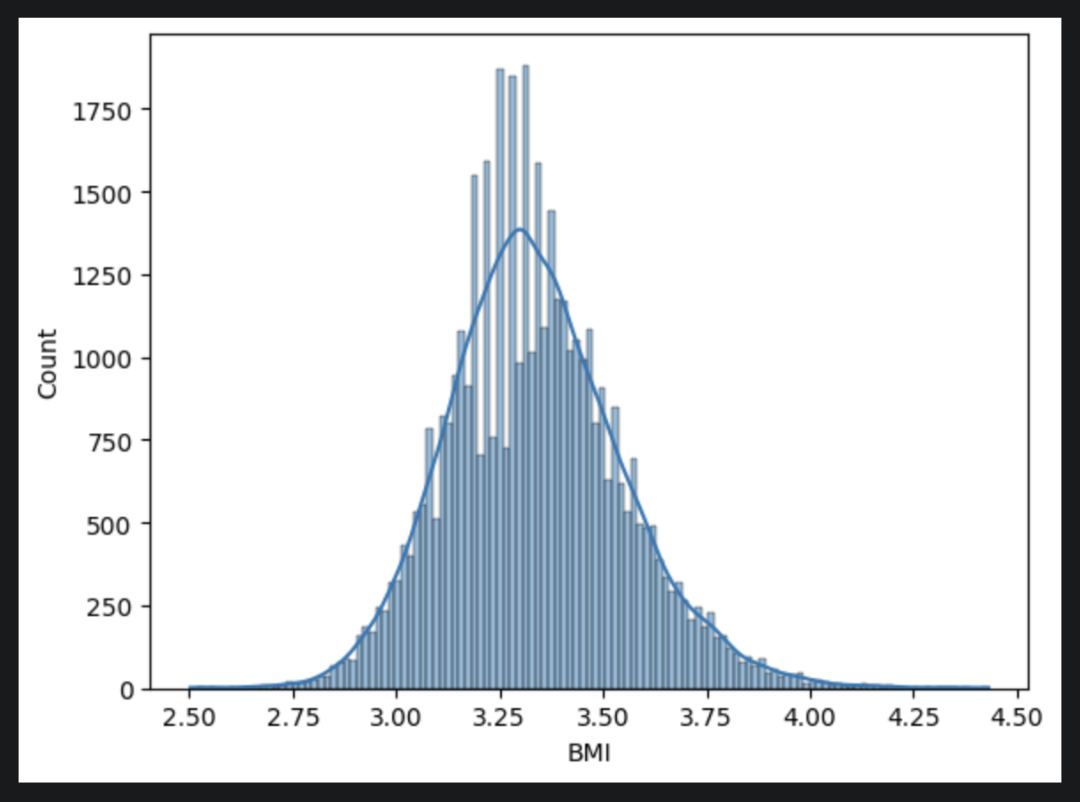
BMI Normalization
Before Normalization
After Normalization

Slide 9
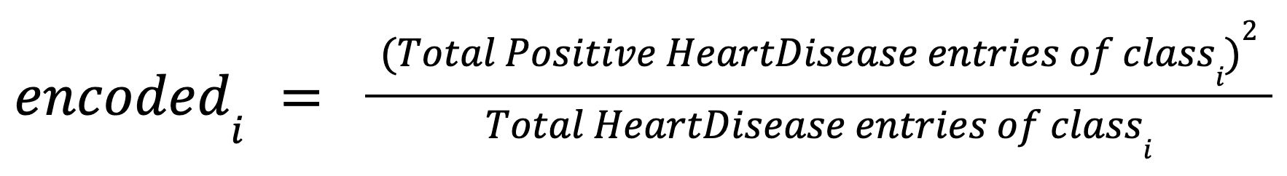
Data Preprocessing - Feature Engineering
Categorical columns in the dataset require normalization before being used in a machine learning model
A straightforward count of occurrences of each class does not accurately represent each class's relation to HeartDisease
A tailored approach was used to calculate a weighted average for each class, taking into account the distribution of HeartDisease entries across each class.
The weighted averages were normalized by applying a log transformation to make the values less sensitive to huge differences
This approach ensures that each class is represented fairly in the model training process, leading to more accurate results.

Slide 10
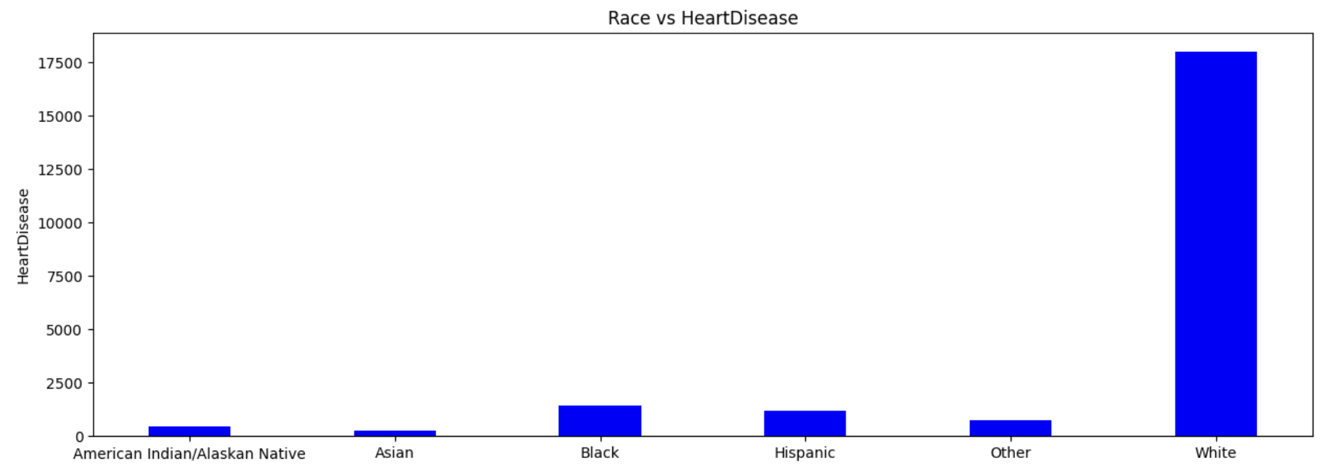
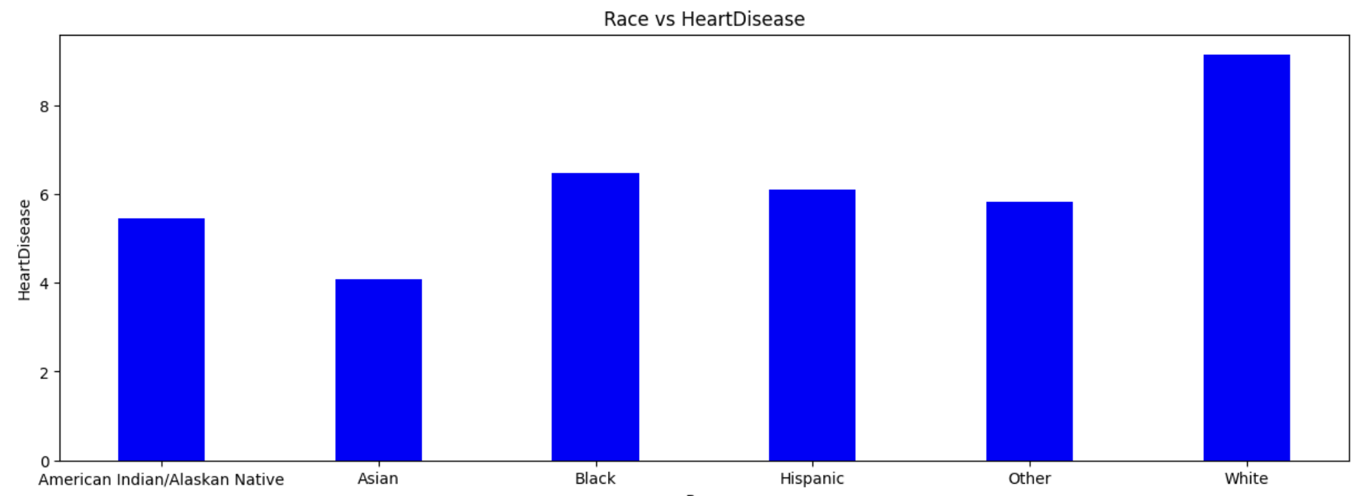
Encoding & Normalization of ‘Race’ Feature
Summing up Total positive HeartDisease entries
Using the formula mentioned

Slide 11
Data Mining Insights:
Race:
Black and Hispanic individuals have higher scores of HeartDisease compared to other races.
Asian individuals have the lowest score of HeartDisease.
There is a significant disparity in HeartDisease risk across different racial groups.
GenHealth:
Individuals with Fair and Poor general health have higher scores of HeartDisease compared to those with better health.
Individuals with Excellent general health have the lowest score of HeartDisease.
There is a clear association between general health and HeartDisease risk.
Gender:
Males have a slightly higher score of HeartDisease compared to females.
However, the difference between the two genders is relatively small.
Age:
HeartDisease risk increases with age, with the highest scores observed among individuals aged 80 or older.
There is a linear relationship between age and HeartDisease risk.
Individuals aged 18-24 have the lowest score of HeartDisease.

Slide 12
Data Mining Insights: - Contd
Diabetes:
Individuals with diabetes, either diagnosed or borderline, have higher scores of HeartDisease compared to those without diabetes.
Pregnant individuals with diabetes have the lowest score of HeartDisease among those with diabetes.
Diabetes is a significant risk factor for HeartDisease.
SleepTime:
Individuals who sleep for 8 hours per night have the highest score of HeartDisease.
HeartDisease risk is relatively low for individuals who sleep for 1-6 hours per night or 11-18 hours per night.
However, there is a significant increase in HeartDisease risk for individuals who sleep for more than 18 hours per night.
The relationship between sleep time and HeartDisease risk is not linear, and there is a U-shaped association between the two.

Slide 13
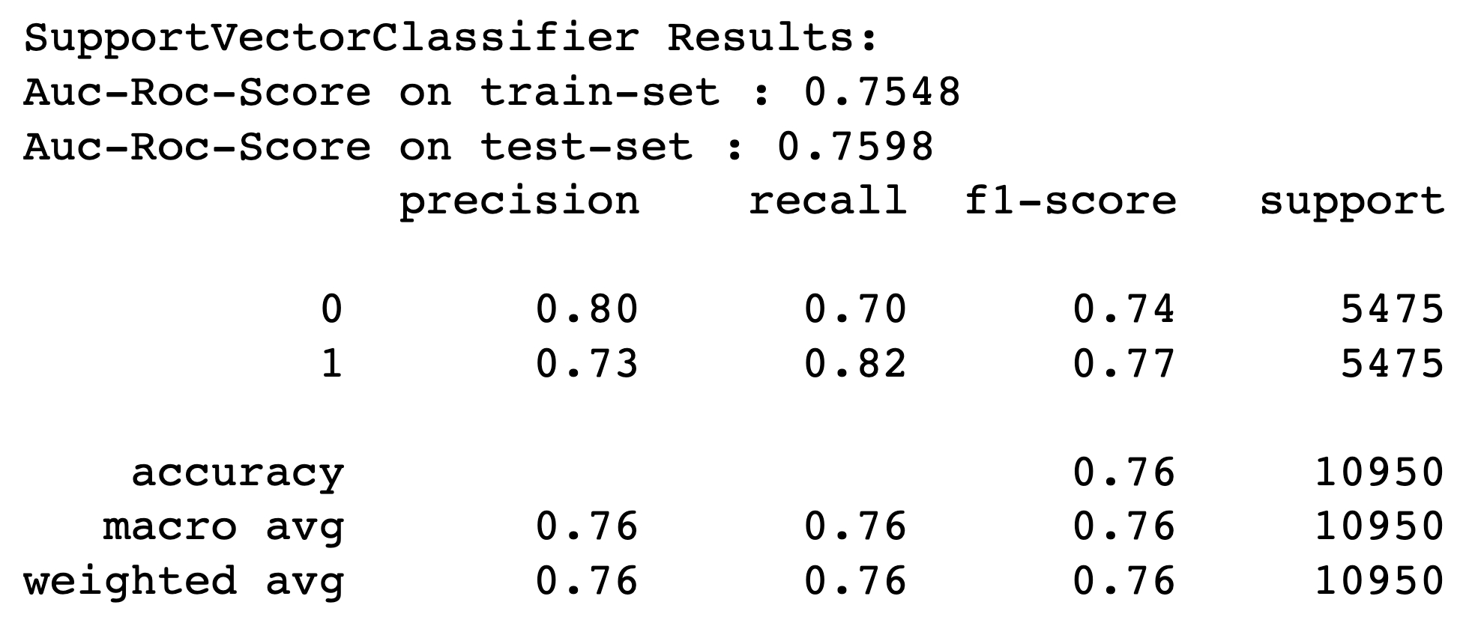
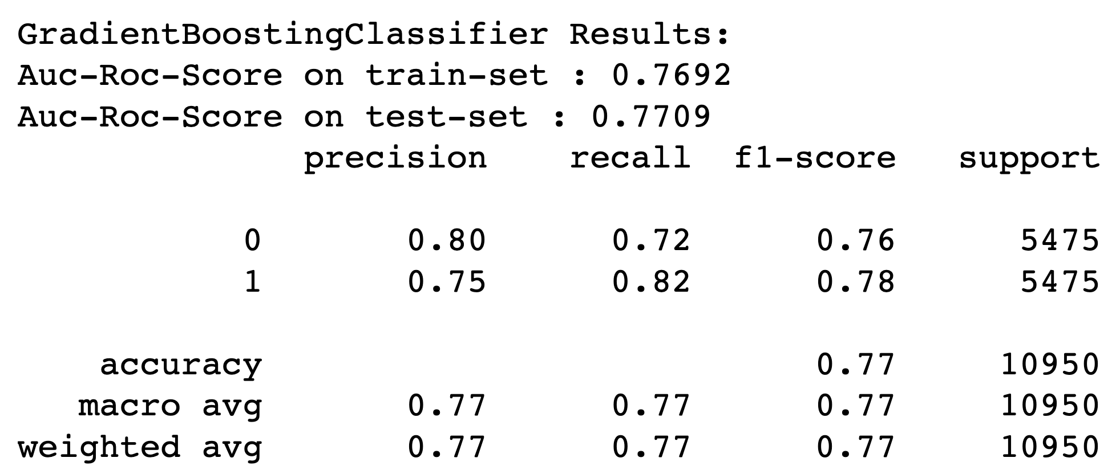
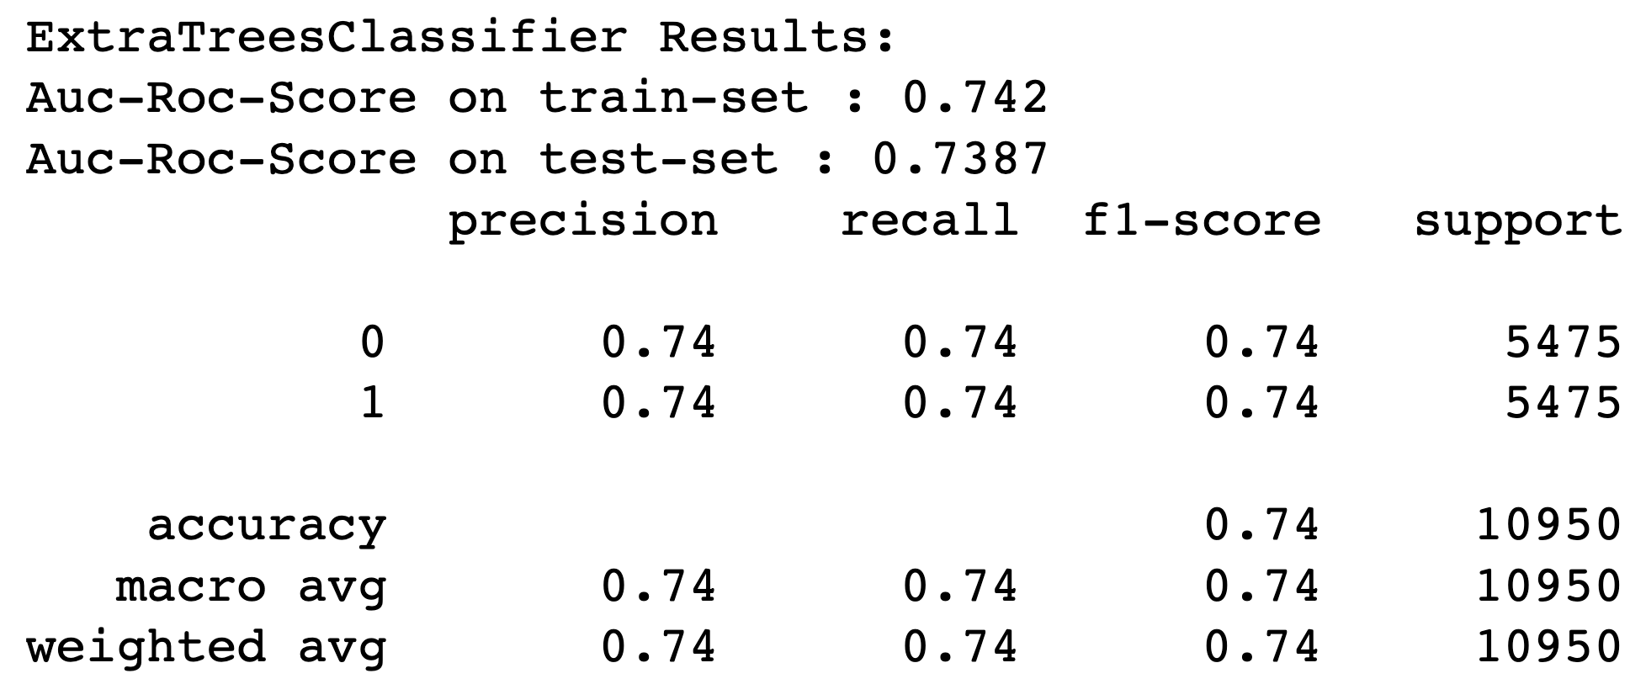
Training Results:
The algorithms evaluated were Support Vector Classifier (SVC), Gradient Boosting Classifier (GBC), and Extra Trees Classifier (ETC).
The AUC-ROC score, precision, recall, f1-score, and overall accuracy were used to evaluate the performance of each algorithm.
The SVC algorithm achieved a moderate level of performance with an overall accuracy of 0.76.
The GBC algorithm performed slightly better than the SVC algorithm with an overall accuracy of 0.77.
The ETC algorithm performed slightly worse than the other two algorithms with an overall accuracy of 0.74.
The results suggest that the GBC algorithm achieved the best performance on the binary classification task, followed closely by the SVC algorithm.

Slide 14
Conclusion
The study evaluated the relationship between various factors and the risk of heart disease, including race, gender, age, diabetes status, general health, and sleep time.
The analysis showed that age, gender, diabetes, general health, and race were significant predictors of heart disease.
The age group with the highest risk for heart disease is the 80 or older age group, with a log transformed score of 8.108.
Gender also plays a role in heart disease risk, with males having a higher log transformed score of 8.885 compared to females with a score of 8.268.
Among the evaluated algorithms, the Gradient Boosting Classifier (GBC) performed the best in predicting the risk of heart disease, followed closely by the Support Vector Classifier (SVC).
The overall accuracy of the GBC model was 0.77, indicating that it correctly classified 77% of cases.
The study highlights the importance of considering various factors in predicting the risk of heart disease and suggests that machine learning algorithms can be effective in predicting disease risk.

Slide 15
References
Kaggle Dataset - https://www.kaggle.com/datasets/kamilpytlak/personal-key-indicators-of-heart-disease
B. Akkaya, E. Sener and C. Gursu, "A Comparative Study of Heart Disease Prediction Using Machine Learning Techniques," 2022 International Congress on Human-Computer Interaction, Optimization and Robotic Applications (HORA), Ankara, Turkey, 2022, pp. 1-8, doi: 10.1109/HORA55278.2022.9799978.
M. Mamun, M. M. Uddin, V. Kumar Tiwari, A. M. Islam and A. U. Ferdous, "MLHeartDis:Can Machine Learning Techniques Enable to Predict Heart Diseases?," 2022 IEEE 13th Annual Ubiquitous Computing, Electronics & Mobile Communication Conference (UEMCON), New York, NY, NY, USA, 2022, pp. 0561-0565, doi: 10.1109/UEMCON54665.
Pal, Madhumita, Parija, Smita, Panda, Ganapati, Dhama, Kuldeep and Mohapatra, Ranjan K.. "Risk prediction of cardiovascular disease using machine learning classifiers" Open Medicine, vol. 17, no. 1, 2022, pp. 1100-1113. https://doi.org/10.1515/med-2022-0508

Slide 16
Thank you
Sanjeev Kumar Srinivasan Khannan
sanjeevkumar.srinivasankhannan@pace.edu
Ph: +1 9298772338

